Slide 1
Advanced Topics in Survival Analysis Part #1
Dr Oliver Perra
Full resource: https://www.ncrm.ac.uk/resources/online/all/?id=20860

Slide 2
Outline
A. Recap: hazard and survivor function for discrete time
B. Hazard and Survivor function when time is continuous
Challenges
From instants to intervals
C. The Kaplan-Meier method
Estimates
Cumulative hazard function
Kernel-Smoothed hazard function
Notes:
I will also highlight the pre-requisites for running survival analysis, highlighting the type of information, data and decisions we need to take to ensure we can meaningfully answer research questions using survival analysi.
In this first presentation I will focus on the concepts and principles underlying survival analysis without presenting models and equations, which I will introduce in the other presentations in these resources.

Slide 3
Recap
Researchers are often interested in investigating the occurrence of events, e.g.:
Onset of puberty;
Symptoms of depression;
Shareholders selling their shares in the stock market.
Notes:
Survival analysis is used when we are interested in studying the occurrence of events as well as the factors that may influence this occurrence and its timing.
Here I give some examples of events of interest. These events may happen only once, for example death of a patient, or the onset of puberty. But we can also apply these methods to re-occurring events, for example we may be interested in the occurrence of depression symptoms over years, whereby some individuals may experience depression symptoms more than.
Another example in finance is studying if and when shareholders will sell their shares in the stock market.
To run survival analyses we need to clearly define an event of interest, that is, a change in participants’ status. For example, individuals move from pre-puberal to puberty, or move from not experiencing depression symptoms to experiencing them.
The other key precursor to survival analysis is identifying the “start of time”: when we are interested in events occurrence, we need to identify a point where all participants are in one status. In the puberty example, we need to identify an age when all participants had not yet started puberty. In the stock market, the beginning of time may be the opening time of the stock market, that is, a point where all shareholders own their shares, before operations starts.
For an introduction to Survival Analysis, you can refer to the resources I had created for NCRM.

Slide 4
Survival Analysis
A metric for time:
Record time in the smallest possible units relevant to the event of interest.
Continuous time
Discrete time
Notes:
It is then important to specify a metric of time: what are the units that researchers will use to record the passing of time?
With current technology it may be possible to have very precise measures of event occurrence. However, some type of events can only be recorded within discrete intervals: for example, career progression within academia takes place within years, not months or days.
As I will illustrate in what follows, even when we can record the event taking place using a very precise time measurement, most time we need to constrain the measurement within time intervals.

Slide 5
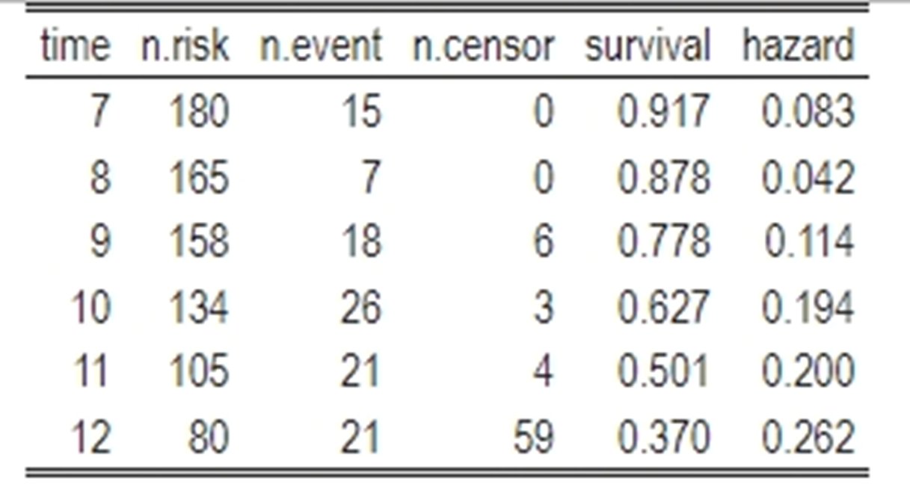
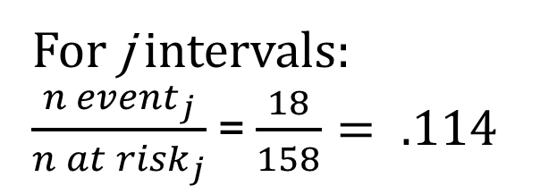
Discrete-time Hazard Function:
Conditional probability that individual will experience the event in the given interval, provided the participant did not experience it in any previous time period.
For j intervals:
$\frac{{n event}_{j}}{{n at risk}_{j}}$ = $\frac{18}{158}= .114$
Notes:
A key statistic in survival analysis is the hazard function.
A premise here: I will focus mostly on non-repeatable events in the rest of these presentations, since they are easier to understand. So, I will focus on events that can only happen once, like death.
When we consider non-repeatable events, the hazard function represents the risk that a participant in the study will experience the event within a time interval, which I indicate generically with the letter j, if the individual has not experienced the event before this interval. In other words, the hazard function indicates the risk of the event occurring within a specific interval j.
The table here is a life-table from a study in which male secondary students reported if they had their first sexual intercourse. The students reported ever sexual intercourse within each school year, so the “time” intervals here are school grade years.
The hazard function in this case is calculated simply by dividing the number of participants who experienced the event within that interval by the number of participants that were at risk of experiencing it at the start of the interval. In other words, is the the number of participants who experienced the event for the first time within the interval divided by the number that had not yet experienced it at the beginning of the interval. In this example, if we take grade 9, highlighted here, the hazard function is 18 divided by 158.
I will also highlight that, when we consider events measured in discrete time, the hazard function is a conditional probability: it represents the probability of event occurrence conditionally on participants not having experienced the event before.

Slide 6

Continuous time Hazard Function
Conditional probability a participant will experience the event at a given time, provided the participant did not experience it before that time.
Notes:
When we measure event occurrence using a continuous measure of time, we encounter a problem. The issue is that there is an infinite number of instants where the event can take place. Which means, the probability of an event taking place at any given time will approach 0 as the units of time become smaller.
Consider for example we want to measure the first occurrence of craving for tobacco during a day among a group of people who are trying to quit. This first occurrence of cravings can be measured in hours and minutes, but even then, if we had better instruments, we could potentially measure it in seconds, or, in principle, even in milliseconds, and so on. Which means that we can potentially break down time into infinitesimally small units, making the probability of an event occurring within a given time virtually 0.

Slide 7

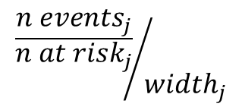
Continuous time Hazard Function
Conditional probability a participant will experience the event at a given time, provided the participant did not experience it before that time.
Conditional probability per unit of time a participant will experience the event during a unit of time (interval), provided the participant did not experience it before that unit of time (interval).
5 min
$${\frac{{n events}_{j}}{{n at risk}_{j}}}/{{width}_{j}}$$
Notes:
This problem is resolved by cumulating instants in time into intervals. In other words, time is divided into a series of intervals. For example, if we measure event occurrence in minutes, minutes are just intervals made up of 60 seconds. In this example, we measure the occurrence of the event within 5-minute intervals
This may seem trivial, but it has an important implication, because the hazard function is calculated as the probability of the event taking place in a specific interval, provided it did not occur before, as the interval width approaches 0. But since we are considering probability of events within intervals, this probability will change with intervals of different width. If we considered the probability of experiencing craving for the first time within minutes, the probability will change when we consider intervals of 1 or 5 minutes.
T o ensure we have a common metric, we must divide the conditional probability of the event taking place in the interval by the intervals’ width. But by doing so, the hazard function does not represent a probability, but rather a rate.
In this example, we considered intervals of 5 minutes, so the hazard function will represent the conditional probability of the event taking place each 5 minutes.

Slide 8

Continuous time Hazard Function: Interpretation
Repeatable event:
The rate at which an individual can expect the event will take place per unit of time
5 min
Non-Repeatable event:
The percentage of individuals in a population who experience the event for the first time per unit of time
Notes:
.Note that when the event is repeatable, the interpretation of the hazard function is linked with an individual, represents how often an individual can expect the event to take place per unit of time. If we considered that cravings for cigarettes can happen more than once in a day, the hazard function here will represent the expected number of cravings per 5 minutes
But if the event is non-repeatable, the interpretation of the hazard rate is linked with a hypothetical population of individuals: For example, if we are studying how long before investors sell the shares of a company during a specific day in the stock market and we consider unit of times in periods of 5 minutes, a hazard rate of 0.04 means that within a 5-min interval, we expect 4% of investors that still hold the company’s shares to sell them.

Slide 9
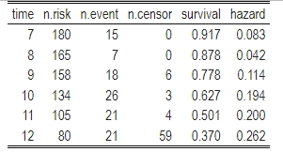
Survivor Function: Discrete Time
Probability of “surviving” past a time interval j for a randomly selected individual i.
(1- .042) survive in the year.
But only .917 from original sample are still at risk.
Therefore:
(1- .042) * .917 = .878
Notes:
I will come back to the hazard function with a practical example.
But now, the other important function in Survival Analysis is the survivor function, which is the probability that a randomly selected participant will survive, that is, will not experience the event whiting a time interval j. A key distinction is that the hazard function represents risk uniquely associated with an interval. The survivor function cumulates information about the inverse of risk, that is event non-occurrence, over intervals.
Since hazard is an indicator of occurrence and survival of non-occurrence, they are linked. In the example of the first sexual intercourse study, we showed that the probability of non-occurrence in a discrete time period like year is the inverse of the hazard function, multiplied by the survivor function of the previous period, so that we take into account the reduction in the risk set in the previous interval.

Slide 10
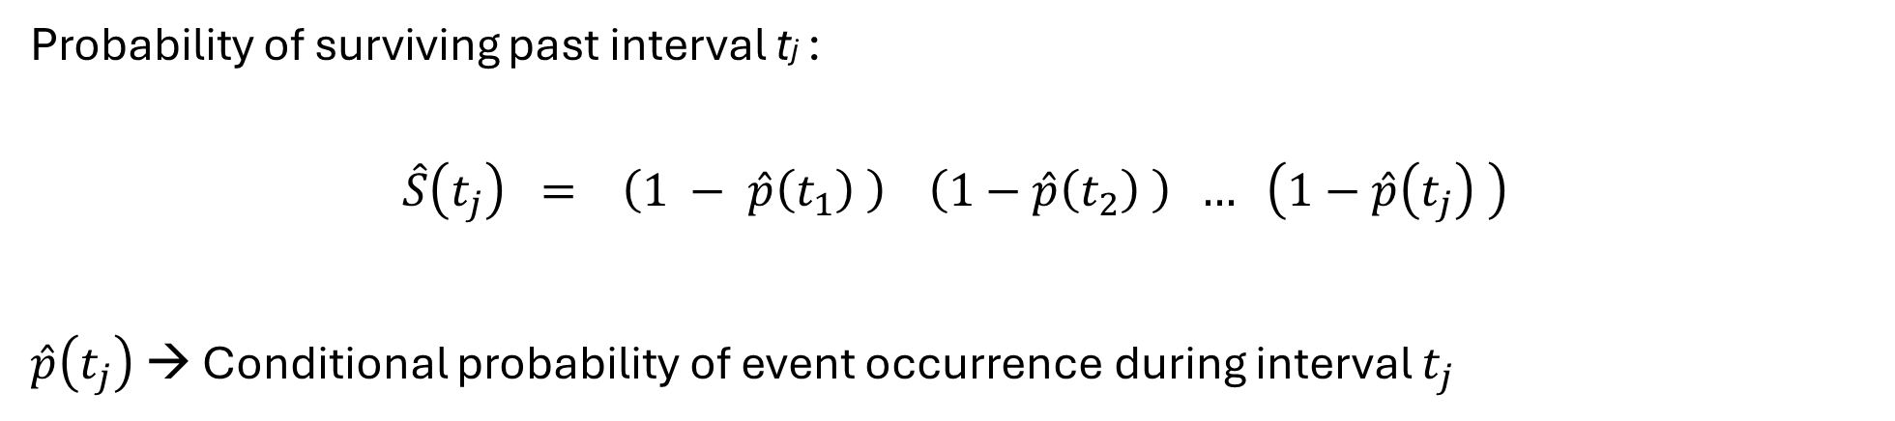
Survivor Function: Continuous Time
t1
t2
…
tj
5 min
Probability of surviving past interval tj :
$$\hat{S}\left(t_{j}\right) = \left(1 − \hat{p}\left(t_{1}\right) \right) \left(1−\hat{p}\left(t_{2}\right) \right) … \left(1−\hat{p}\left(t_{j}\right) \right)$$
$\hat{p}\left(t_{j}\right)$ → Conditional probability of event occurrence during interval $t_{j}$
Notes:
When we consider discrete times, we use the same logic, once we consider discrete time into small intervals, rather than instants, as discussed before.
The discrete-time estimator of the survivor function at time tj is the probability of surviving past interval tj: We obtain this by multiplying the successive probabilities of surviving through each interval from the interval 1 to interval tj. These probabilities are just the complement of the conditional probability of experiencing the event during the interval, here indicated as p hat, so we can express the survivor function with the formula just here.

Slide 11
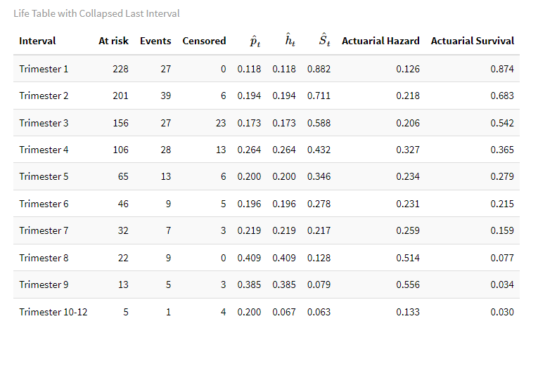
Life Table: Continuous Time
Dataset “lung” from “survival” R library
Number of days until lung cancer patients pass away.
Event: Patients’ death
Time unit: Day→ Trimesters
Notes:
So, if we want to summarise data when events have been recorded using a continuous time metric, how can we do that?
Here is an example of life table. The dataset is called lung, and is available with the “survival” R library. Please refer to the course material if you want to check how I transformed the dataset and calculated the statistics.
The target event is death of lung cancer patients. The occurrence of the event is calculated in days. However, in order to summarise the data, I can use different time intervals. I could use months, hence report the hazard and survivor function of patients every month. In this example, I used trimesters, periods of 3 months. I could have used years.
The choice depends on criteria such as finding intervals that are meaningful, large enough to produce stable estimates, but also fine enough to reveal patterns of interest. So it’s a difficult balance.
Note also that I collapsed the last three trimester into a single interval. It’s possible to summarise data for intervals of different length. In this case, I did that since the risk set in the last three trimester was just 5 participants and only one did experience the event within these three trimesters.
The p-hat represents the conditional probability of event occurrence within the interval, the h-hat the estimated hazard function, the S-hat the estimated survivor function. Note that p-hat and h-hat are identical in all the rows save for the last one because the unit of time here is trimester: hazard function is calculated as the conditional probability divided by the interval width, and since the unit of time is trimeter, the interval width is 1 in all the rows, save for the last one where the interval width is 3 trimesters.
The actuarial hazard and survival estimates are calculated in a similar way to the previous ones, with the difference that these estimates introduce some corrections that reflect the assumption that all events and censoring are distributed equally throughout the time interval of interest. This is analogous to assuming that events and censoring take place at random during the interval. These actuarial estimates partly adjust for the categorization of time. You can find more information in the references. In general, they provide similar estimates to the other ones. Here, we can see that risk of death seems to be relatively stable, to then increase over trimesters 8 and 9, i.e. around the end of 2nd year post-diagnosis. However, bear in mind that the risk set is a lot smaller in the latter intervals, hence the estimates tend to be more erratic.

Slide 12
Kaplan-Meier Method
AKA product-limit method: maximum-likelihood properties.
t0
t1
t4
t5
t2
Notes:
I will now introduce the Kaplan-Meier method to analyse discrete time event occurrence. This also known as the product-limit method. One of the advantages is that it has ML properties.
The key intuition is extending the discrete time method: but rather than rounding event times to create pre-set intervals like periods of 5 minutes, the method uses the raw event times to create intervals whereby each interval contains one observed event occurrence. In other words, the initial interval will be between t0 and t1 when the first event takes place; the second interval will between t1 and t2, when the second event takes place… and so on. Conventionally, the first interval ends just before the occurrence of the first event, and as soon as the event takes place, a new interval starts, which ends as soon as the event takes place again, and so on. The last interval ends as soon as the last event takes place, or it ends at infinity if the last recorded time corresponds to censoring.
Given this, we can compute the conditional probability of event occurrence in the same way I illustrated before, and then multiply the complements of these probabilities to obtain the Kaplan-Meier estimate of the survivor function.

Slide 13


Kaplan-Meier Method
AKA product-limit method: maximum-likelihood properties.
t0
t1
t4
t5
t2
Conditional probability of
event occurrence :
Survivor Function:
Hazard Function:
$\hat{p}\left(t_{1}\right)= \frac{n event(t_{1})}{n at risk(t_{1})}$
$\hat{h}\left(t_{j}\right)= \frac{\hat{p}\left(t_{j}\right)}{width(j)}$
$$\hat{S}\left(t_{1}\right) = \left(1 − \hat{p}\left(t_{1}\right) \right)$$
$\hat{p}\left(t_{2}\right)= \frac{n event(t_{2})}{n at risk(t_{2})}$
$\hat{S}\left(t_{2}\right) = \left(1 − \hat{p}\left(t_{1}\right) \right)$ $\left(1 − \hat{p}\left(t_{2}\right) \right)$
…
$\hat{p}\left(t_{j}\right)= \frac{n event(t_{j})}{n at risk(t_{j})}$
$$\hat{S}\left(t_{j}\right) = \left(1 − \hat{p}\left(t_{1}\right) \right) \left(1−\hat{p}\left(t_{2}\right) \right) … \left(1−\hat{p}\left(t_{j}\right) \right)$$
Notes:
Here I provide the formulae..
So, the conditional probability is defined as the number of participants who experienced the event within an interval divided by the number of participants who had not yet experienced the event at the start of the interval. The survivor function is defined as the cumulative product of the inverse conditional probability.
Kaplan-Meier estimate of the hazard function will thus be obtained by dividing the conditional probability of event occurrence in an interval by the width of the interval.

Slide 14





Example Kaplan-Meier Method: “Lung” Dataset
…
12
0
5
11
Conditional probability of
event occurrence :
Survivor Function:
Hazard Function:
$$\hat{S}\left(t_{5}\right) = \left(1 −0.0044\right)=0.9956$$
$\hat{h}\left(t_{5}\right)= \frac{0.0044}{11−5}= .0007$
$\hat{p}\left(t_{5}\right)= \frac{1}{228}=0.0044$
$\hat{p}\left(t_{11}\right)= \frac{3}{227}=0.0132$
$$\hat{S}\left(t_{11}\right) = \left(1 −0.0357\right)\left(1 −0.0132\right)=0.9825$$
$\hat{h}\left(t_{11}\right)= \frac{0.0132}{11−12}= .0132$
$\hat{p}\left(t_{j}\right)= \frac{events(t_{j})}{n at risk(t_{j})}$
$$\hat{S}\left(t_{j}\right) = \left(1 − \hat{p}\left(t_{1}\right) \right) … \left(1−\hat{p}\left(t_{j}\right) \right)$$
$\hat{h}\left(t_{j}\right)= \frac{\hat{p}\left(t_{j}\right)}{width(j)}$
Notes:
So, in this example, I took the data from the “lung” dataset. You can check the data and the operations on it by looking at the material with this course, which provides the R scripts I have used.
If we look at the interval between the first and the second occurrence of the event, the second interval is between days 5 and 11. Note that on day 11 three individuals died, i.e. experience the event for the first time. So we have a tie, an instance where more than one participant experience the event at that precise time.
The conditional probability of event occurrence within the second interval 5 to 11 days is 1 divided the risk set, which was the full sample of 228 participants, since there was yet no censoring.
The conditional probability of death within 11 days is 3, since 3 participants died on day 11, divided by the remaining risk set, that is 227, and so on.
Using these conditional probabilities, we can calculate the survivor functions for each interval, i.e. the probability of a random individual in the dataset to survive past the interval. So, for example, the probability of surviving past 11 days is 98%.
Finally, considering the hazard function, we just divide the conditional probability of event occurrence for each interval by the width of the interval. So, this represents the death rate per day within interval.
As you probably realise already, these hazard functions tend to be very erratic because depend on the interval width. For this reason, they are not provided by most software and not reported.

Slide 15


Cumulative Hazard Function
…
12
0
5
11
Conditional probability of
event occurrence :
Hazard Function:
Cumulative Hazard Function:
$\hat{h}\left(t_{j}\right)= \frac{\hat{p}\left(t_{j}\right)}{width(j)}$
$$H\left(t_{j}\right)={}_{ between t_{0} and t_{j}}^{Cumulation\left[h\left(t_{j}\right)\right]}$$
$\hat{p}\left(t_{j}\right)= \frac{events(t_{j})}{n at risk(t_{j})}$
Notes:
What is reported instead is the “cumulative” hazard function, which is denoted by capital H and then the indicator for the time interval of interest. The cumulative hazard function totals the virtually infinite values of the hazard function that exist between the start of time (t 0) and the interval of interest. Since it cumulates the estimated risk of event occurrence, it does not provide information about unique risk at a specific time, as the hazard function does. Also, since it totals hazard, it has a value that has little meaning on its own. However it is useful in providing insights.
There are two ways to calculate the cumulative hazard function.

Slide 16


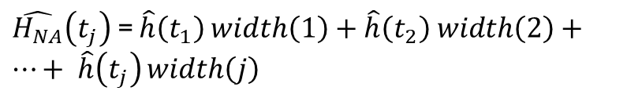


Cumulative Hazard Function
…
12
0
5
11
Conditional probability of
event occurrence :
Hazard Function:
Cumulative Hazard Function:
$$H\left(t_{j}\right)={}_{ between t_{0} and t_{j}}^{Cumulation\left[h\left(t_{j}\right)\right]}$$
$\hat{p}\left(t_{j}\right)= \frac{events(t_{j})}{n at risk(t_{j})}$
$\hat{h}\left(t_{j}\right)= \frac{\hat{p}\left(t_{j}\right)}{width(j)}$
Nelson-Aalen method:
$\hat{H_{NA}}\left(t_{j}\right)$ = $\hat{h}\left(t_{1}\right)$ $width\left(1\right)+\hat{h}\left(t_{2}\right) width\left(2\right)+…+$ $\hat{h}\left(t_{j}\right)$ $width\left(j\right)$
Negative Log Survivor Function:
$\hat{H_{−LS}}\left(t_{j}\right)$ = $−log \hat{S_{km}}\left(t_{ij}\right)$
Notes:
The first and quite commonly used is the Nelson-Aalen method. This is obtained by summing up the product of the hazard function and the interval width across all intervals from interval 1 to the one of interest, here indicated as interval j.
The Negative log survivor function instead uses the link between the hazard and the survivor function, and calculates the negative log of the Kaplan-Meier survivor function to obtain an estimate of cumulative hazard. A warning about notation: here, and in what follows, with log, I indicate the natural log. Log with base 10 are indicated as “log10”. In this way, I follow the type of notation that is used in software like Stata or R.
These estimates are usually similar but diverge as the risk set decreases. The Nelson-Aalen method is more susceptive to censoring.

Slide 17





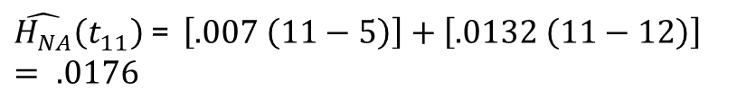
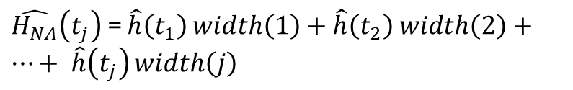
Cumulative Hazard Function
…
12
0
5
11
Conditional probability of
event occurrence :
Hazard Function:
Cumulative Hazard Function
(Nelson-Aalen method):
$\hat{h}\left(t_{j}\right)= \frac{\hat{p}\left(t_{j}\right)}{width(j)}$
$\hat{p}\left(t_{j}\right)= \frac{events(t_{j})}{n at risk(t_{j})}$
$\hat{H_{NA}}\left(t_{j}\right)$ = $\hat{h}\left(t_{1}\right)$ $width\left(1\right)+\hat{h}\left(t_{2}\right) width\left(2\right)+…+$ $\hat{h}\left(t_{j}\right)$ $width\left(j\right)$
$\hat{p}\left(t_{5}\right)= \frac{1}{228}=0.0044$
$\hat{h}\left(t_{5}\right)= \frac{0.0044}{11−5}= .0007$
$\hat{p}\left(t_{11}\right)= \frac{3}{227}=0.0132$
$\hat{h}\left(t_{11}\right)= \frac{0.0132}{11−12}= .0132$
$\hat{H_{NA}}\left(t_{11}\right)$ = $\left[.007 \left(11−5\right)\right]+\left[.0132 \left(11−12\right)\right]$
$= .0176$
Notes:
So, here is an example of how to calculate the cumulative hazard function using the Nelson-Aalen method. You may notice here, since the hazard function is obtained by dividing the interval conditional probability by the interval width, multiplying the conditional probability by the interval width just returns the conditional probability, so that here the cumulative hazard function is equivalent to the sum of the conditional probabilities.

Slide 18
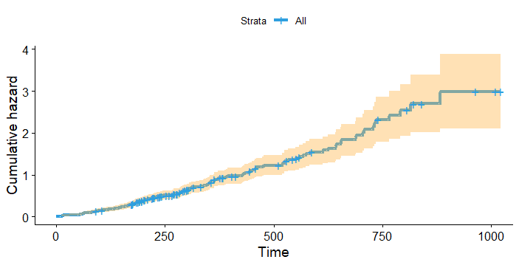
Cumulative Hazard Function
…
12
0
5
11
A key issue:
Cumulative hazard functions draw attention to the upper right tails, which are usually very unstable!
Notes:
Regardless of the method used to calculate the cumulative hazard functions, they have a common problem, that is they draw attention to their upper right tails, but these estimates are usually very unstable.
Here, I tried to highlight this problem drawing the cumulative hazard function with confidence intervals. The line represents the cumulative hazard function for the lung cancer data. The vertical ticks represents censored cases, while the area represents the 95% confidence intervals of the cumulative hazard function.
The confidence intervals indicate greater uncertainty in the estimates in the right side: as more people die or leave the study and are censored, the cumulative hazard function tends to be based on smaller risk sets, so the estimates become more unstable. It is therefore more advisable to focus on earlier and more stable sample estimates.
The cumulative rate hazard is particularly useful in identifying periods where the rate of change in risk changes, so we can use it to identify periods where the “average slope” of this function changes.
Once again, please refer to the R scripts attached with these resources to see how to calculate these functions and create the graphs.

Slide 19
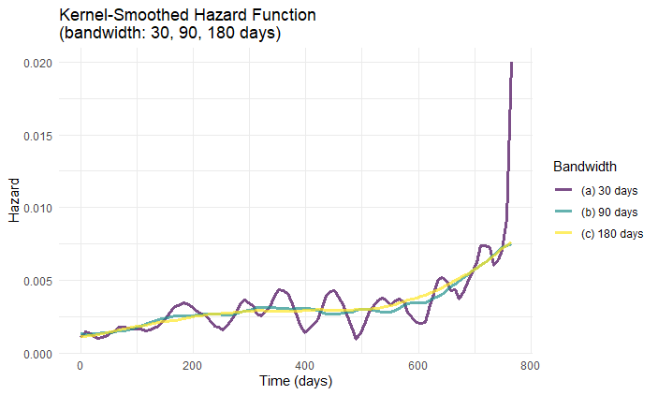
Kernel-Smoothed Hazard Function Estimates
…
12
0
5
11
Aggregate point estimates within “vicinity” of focal point:
Bandwidths define the “vicinity” of aggregated point estimates.
Notes:
So, I mentioned that the hazard function estimates are too unstable. However, they only provide estimates of the unique risk in specific time intervals. To still use the hazard function estimates to get insights into the phenomena of interest, we can rely on kernel smoothed estimates. These basically estimate the average of a function by aggregating together all the point estimates that are within the temporal vicinity of a focal time point. In other words, they provide approximate values based on estimates near the focal point.
As you can imagine though, the shape of these averaged estimates depend on what we define the “vicinity” of the focal point: this is called the bandwidth, which is basically the interval that will provide the point estimates that are aggregated.
We can choose different bandwidths for these smoothed estimates. Here I provide three examples based on the lung cancer data.
The first bandwidth is 30 days. So, for example, if we take a focal point of 35 days, we will aggregate all point estimates of risk of death between 5 and 70 days to create the smoothed estimate.
The other two bandwidths are 90 days, and 180 days.
As you can see, the narrower one provides estimates that are more erratic, whereas they are smoother as the bandwidth becomes larger.
While we may like the smoother lines, we also need to consider that widening the bandwidth introduces more bias. If we take the estimated hazard at 35 days, in the first 30-day bandwidth, this value represents the average population hazard between days 5 and 70. But when the bandwidth is 90 days, the estimated hazard at 35 days represents the average population value between 0 and 120 days! While the estimates are smoother and less erratic, when we widen the bandwidth, we risk losing the meaning of the individual values!

Slide 20
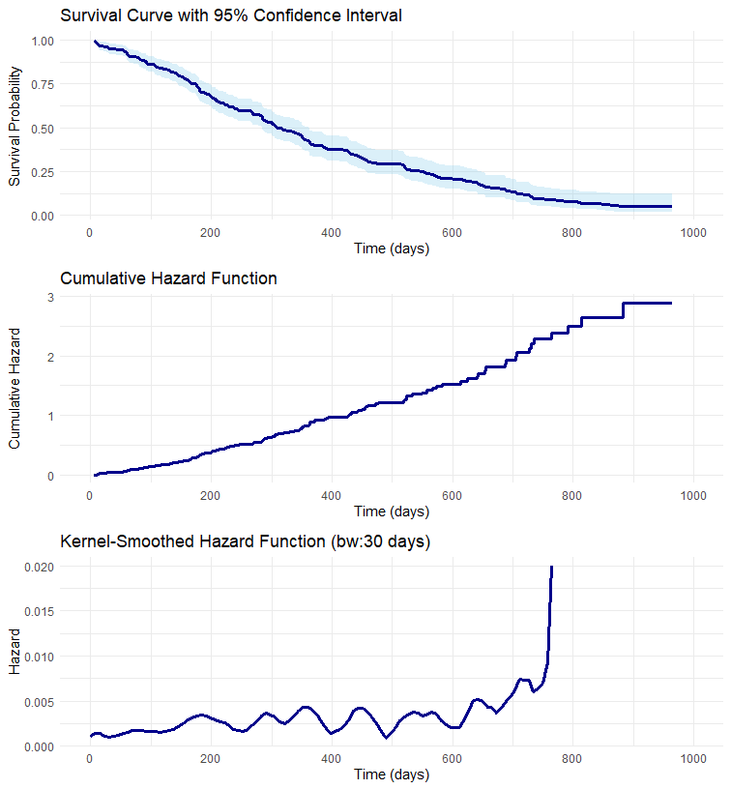
Interpreting Results
…
12
0
5
11
Notes:
One final point here is that since the different statistics in this presentation provide different types of information, it is important to consider them to get some insight the phenomena of interest.
The dataset here is still the lung cancer dataset. We can start with the Kaplan-Meier survivor function, which is easier to interpret because it has a more intuitive metric. The cumulative and smoothed hazard functions can then provide information about periods of higher or lower risk.

Slide 21
Summary
Continuous time event occurrence requires defining time intervals as unit of analysis
Kaplan-Meier Method
Survivor Function: Probability of participant surviving past the interval of interest;
Hazard Function: Conditional probability of event occurrence per time unit (provided event did not occur before)
Cumulative Hazard Function: E.g., Nelson-Aalen
Notes:
To summarise:
Analysing event occurrence when time is measured continuously causes some challenges that can be tackled by defining small but informative time intervals for data analysis. This effectively means that the time metric in analyses can differ from the metric of data collection. We may record some events like infants’ gaze movements in milliseconds thanks to the advent of eye-tracking, but often the time units in analyses are seconds.
I introduced the Kaplan-Meier method that allows to provide ML estimates of the probability of a randomly selected participant surviving past the interval of interest; The method also allows to calculate the hazard function, which represent a rate, that is the probability of event onset per unit of time. Since these estimates tend to be too erratic because of the variability in time intervals, it is common practice to inspect the smoothed hazard functions, with particular care in choice of the bandwidth used in the smoothing process.
Finally, the cumulative hazard function provides insight into the rate of change in hazard, which can provide further insights. All these indicators are very important together, so researchers should inspect them to develop interpretations concerning the phenomena under study.

Slide 22
www.ncrm.ac.uk

